Slide 1


HOME APPLIANCE AUTOMATION USING IOT
Experiment 2
Raphael S. Nano
CPE162P / C1
Computer Engineering Department
School of Electrical, Electronics, and Computer Engineering

Slide 2
Introduction: Home Appliance Automation Using IoT
Appliance controllers provide a wide range of functionality, from timers to complicated IoT devices
It became a vital part of modern houses
Highlight an appliance controller's capabilities and building methods in order to further expand its usefulness

Slide 3
Objectives
To demonstrate how a home appliance automation using IoT works.
To be able apply what you have learned in logic circuits and switching theory, microprocessors, CPE160P, and CPE161P.
To be able to apply embedded system with IoT using Arduino kit
To be able to use ThingSpeak for the data collection and analysis.

Slide 4
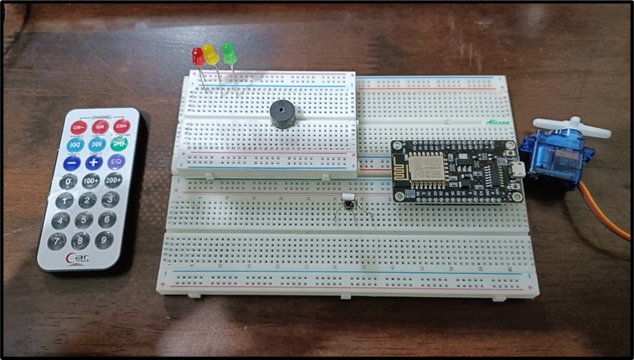
Materials
Hardware
ESP8266 WiFi Module
LEDs
Passive Buzzer
Servo Motor
Infrared Remote
Infrared Receiver
Notes:
The materials utilized to construct the real-time basketball scoreboard are the Arduino UNO, the 4-digit seven segment display, and 5 switch buttons.

Slide 5
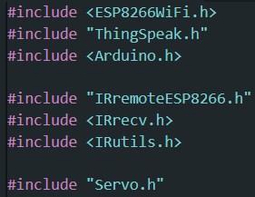
Materials
Software Libraries
ESP8266WiFi.h
ThingSpeak.h
IRremoteESP8266.h
Servo.h

Slide 6
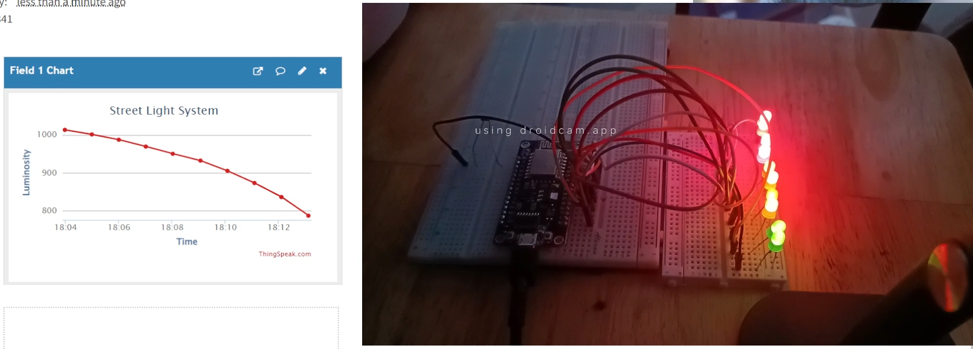
Discussion: Home Appliance Automation Using IoT
Goal is to build an electronic device that can be used to control all the home appliances using Bluetooth technology
The system will be used to switch ON/OFF the devices by giving commands using the IR remote
ThingSpeak will be used for the collection of the data and analysis.

Slide 7
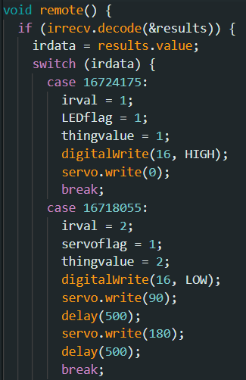
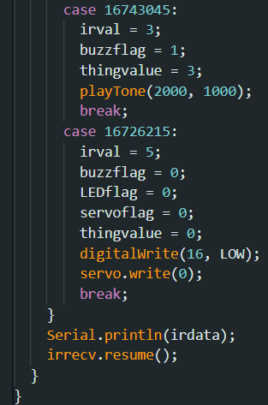
Discussion: Home Appliance Automation Using IoT
Component to be controlled is decided by the value pressed in the remote
1: LEDs
2: Servo Motor
3: Buzzer
5: All OFF

Slide 8
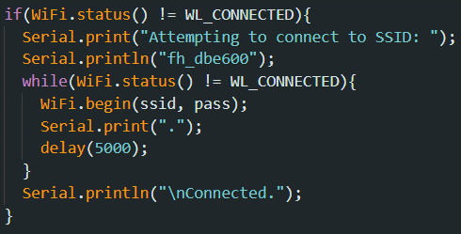
Discussion: Home Appliance Automation Using IoT
To connect the ESP8266 to Thingspeak, a WiFi connection should first be established.
The code tries to get connected to a particular network using Wi-Fi (fh_dbe600) and repeatedly attempts until an adequate connection is made.
It delivers information to the person using it via the Serial Monitor, indicating the status of the connection attempt.

Slide 9
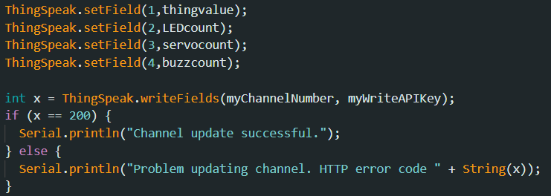
Discussion: Home Appliance Automation Using IoT
The corresponding count for each component will be passed to the corresponding fields
All throughout the span of days, the counts of the usage of components will continue to increase

Slide 10
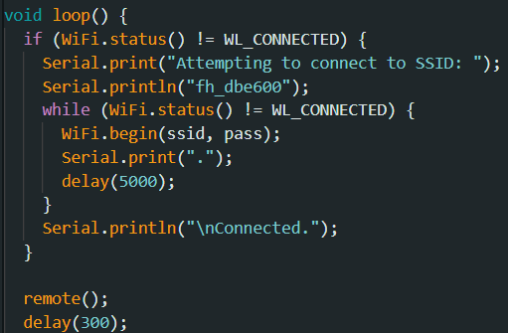
Discussion: Home Appliance Automation Using IoT
The WiFi connection will first be established, then remote() function is first called
Depending on what was pressed, the component will be activated: LEDs for 1, servo motor for 2, and buzzer for 3.

Slide 11
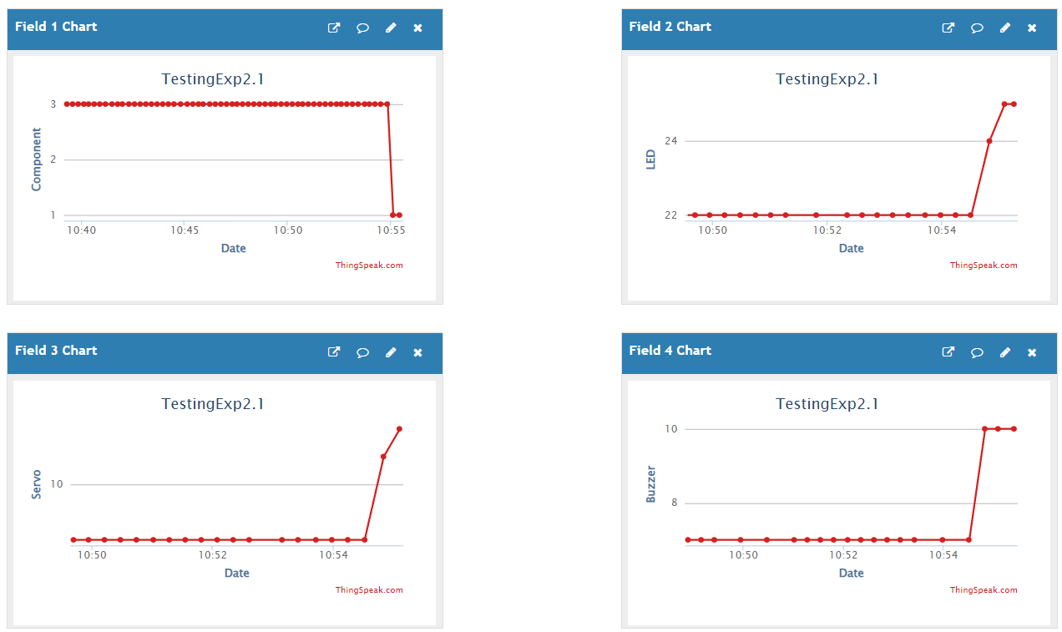
Results: Home Appliance Automation Using IoT

Slide 12
Conclusion
The Home Appliance Automation Using IoT works by:
  using a switch case for the IR remote
  the button determines what component will be activated and what value will be passed to ThingSpeak
  every press of the button from the IR remote would automatically update the system

Slide 13
Conclusion
The second objective was achieved by:
  properly connecting the lighting up of LEDs, the rotation of the servo motor, and the alarming of the buzzer
  synchronizing the component value in Thingspeak
The IoT portion was successfully integrated with the use of the communication and data writing between ESP8266 and Thingspeak
The Home Appliance Automation Using IoT was successfully developed with its Wi-Fi connection and the synchronization of outputs of the IR remote and output devices in Thingspeak.

Slide 14
Creation of the Experiment

